Slide 1
Mapping the Global Intellectual Landscape
Teja Vineeth Reddy Yeramareddy

Slide 2
Questions to Consider?
How do publication trends for different institutions vary over time? Are there differences in peaks and troughs of output between institutions that could point to key events or evolving priorities?
What interplay can be seen on the global citation atlas between country-level citation patterns and cross-border collaboration flows?
What disparities exist across different states or regions in the USA map visualization regarding specialization in particular subfields? Can we identify cases where neighboring institutions have very divergent areas of focus despite geographic proximity?
How do the relationships between metrics like publications, citations, h-index and ranking differ across domains and subfields on the correlation map? Does the relative importance of productivity vs impact measures vary depending on research area?

Slide 3
Introduction
Purpose: Visualize the global landscape of scholarly/intellectual contributions over time and across countries to identify patterns, trends, influential institutions and individuals.
Dataset: Comprehensive dataset capturing publications, citations, h-index and other metrics for researchers and institutions across disciplines and timeperiods

Slide 4
Snapshot of the Dataset
authfull | inst_name | cntry | np6021 | firstyr | lastyr | rank (ns) | nc9621 (ns) | h21 (ns) | hm21 (ns) | nps (ns) | ncs (ns) | cpsf (ns) | ncsf (ns) | npsfl (ns) | ncsfl (ns) | c (ns) | npciting (ns) | cprat (ns) | np6021 cited9621 (ns) | self% | rank | nc9621 | h21 | hm21 | nps | ncs | cpsf | ncsf | npsfl | ncsfl | c | npciting | cprat | np6021 cited9621 | np6021_d | nc9621_d | sm-subfield-1 | sm-subfield-1-frac | sm-subfield-2 | sm-subfield-2-frac | sm-field | sm-field-frac | rank sm-subfield-1 | rank sm-subfield-1 (ns) | sm-subfield-1 count
Medda, Francesca | QASER Laboratory | afg | 80 | 1998 | 2022 | 280798 | 931 | 15 | 8.833333 | 3 | 297 | 36 | 499 | 69 | 814 | 3.009462 | 887 | 1.049605 | 50 | 0.051 | 316276 | 981 | 15 | 9.166667 | 3 | 301 | 36 | 513 | 69 | 843 | 3.014201 | 929 | 1.055974 | 51 | 0 | 19 | Logistics & Transportation | 0.175 | Urban & Regional Planning | 0.075 | Economics & Business | 0.45 | 549 | 485 | 24981

Slide 5
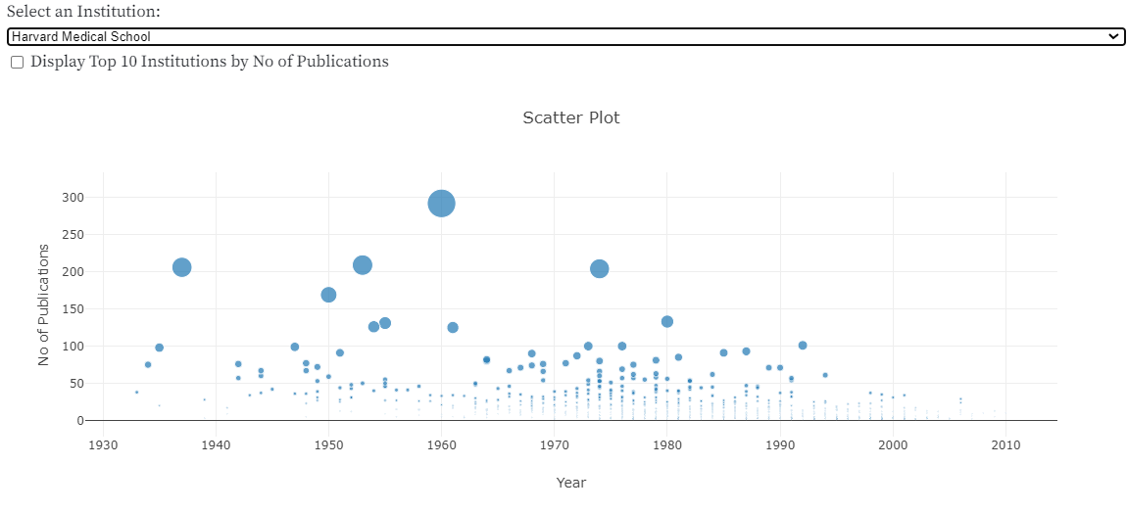
Visualization Choices
Plot-1 : Scatter Plot Over Time
Chosen to show temporal pattern of publications over the years
Allows identification of growth trends and pivotal moments
Interactive elements like zooming and details on hover to facilitate analysis

Slide 6
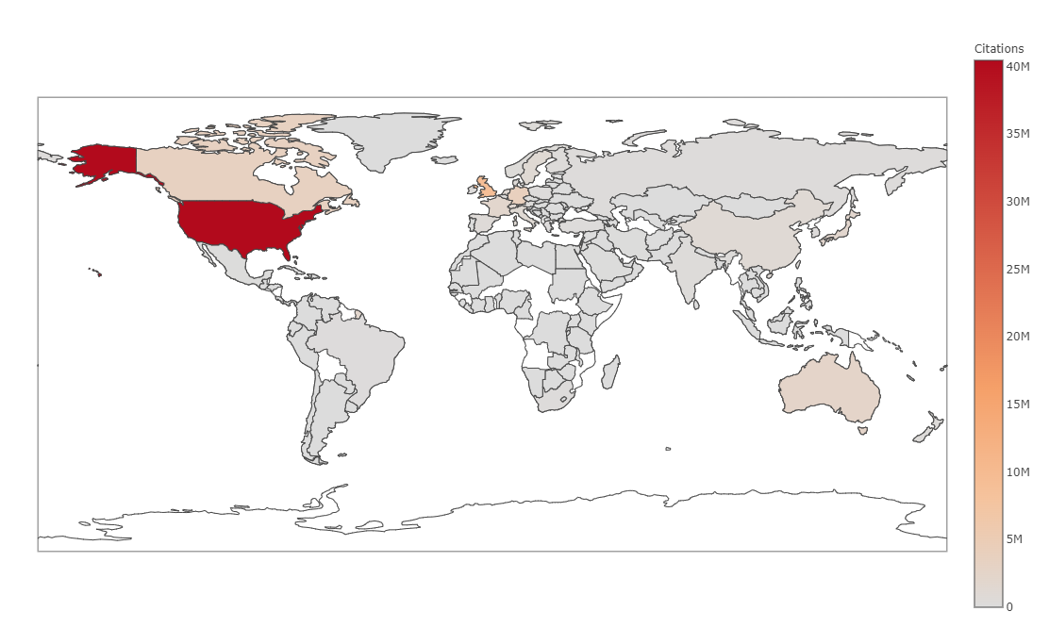
Plot-2 : Heat Map of Global Citations
Utilizes color gradient and shading to convey citation volume by country
Enables easy identification of influence "hot spots" and regional clusters
Interactive tooltips reveal details for each country

Slide 7
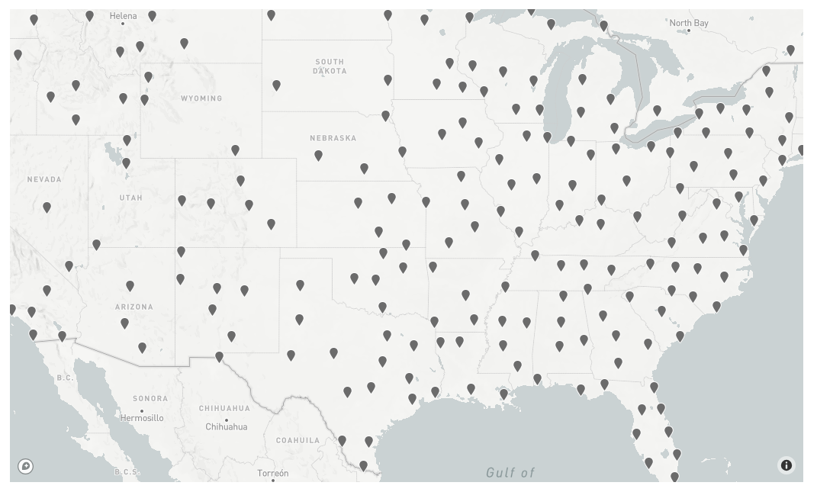
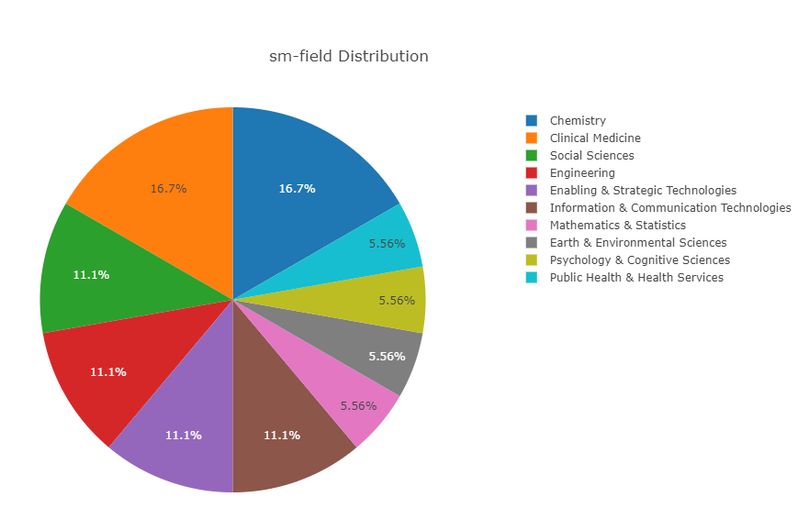
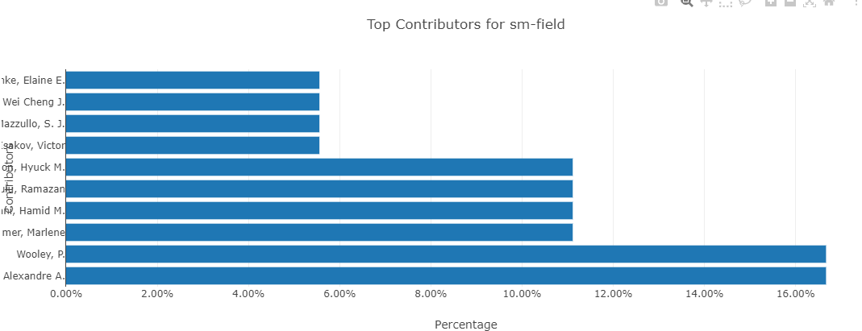
Plot-3 : US Map + Sub-field Pie-Chart + Contributors Bar Graph
Maps geographic distribution of institutions within USA
Pie charts show research profile and breakdown for each institution
Interactive elements to explore subfield contributions and key contributors

Slide 8
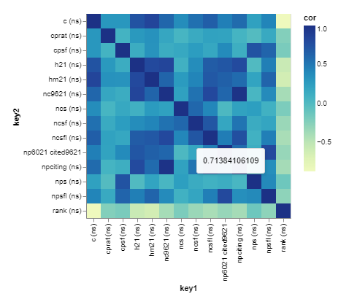
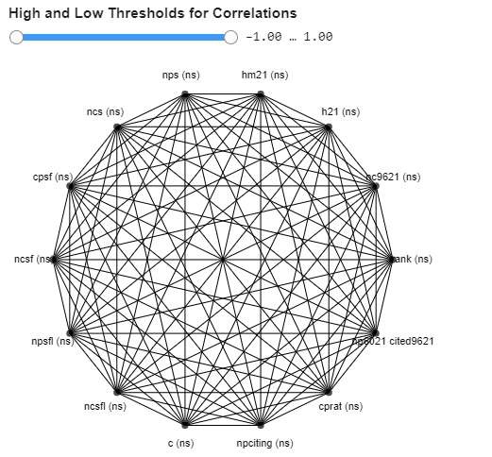
Plot-4 : Correlation Matrix
Visualizes strength and direction of correlations between metrics
Cluster analysis to identify connections between researchers
Insights into relationships between metrics

Slide 9
Key Insights
Dynamic exploration of scatter plot
Insights from institution pie charts

Slide 10
Conclusion
Interconnectivity of global research
Evolution and growth patterns
Influential contributors and institutes

Slide 11
Thank you

